Slide 1


OOP SECOND SEMESTER PROJECT
BY MAM MARYAM

Slide 2
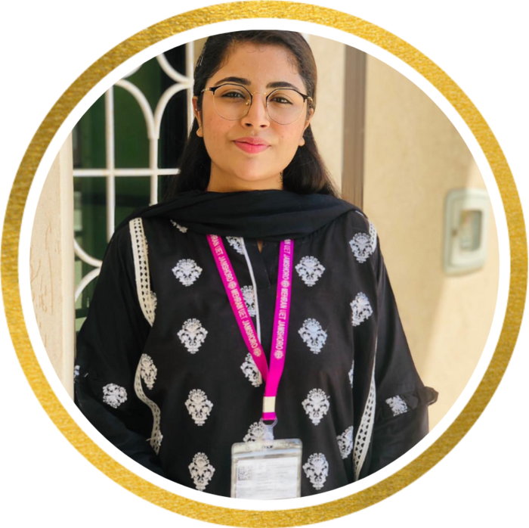
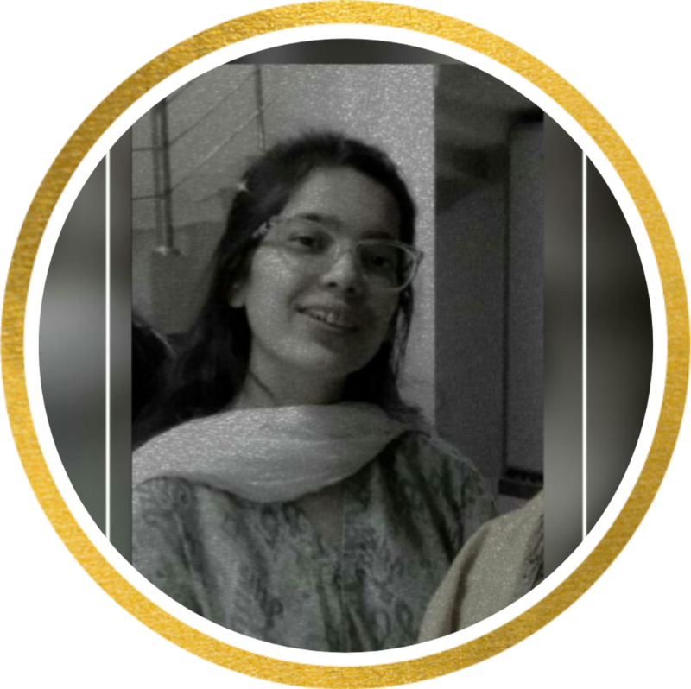
DEVELOPED BY :
KUBRA GHAFOOR
KINZA ASLAM
20SW056 (SEC-1)
20SW071 (SEC-1)

Slide 3
CONVERTER
CURRENCY AND TEMPERATURE CONVERTER

Slide 4
WE HAVE USED OOP CONCEPTS AND GUI IN THIS PROJECT

Slide 5
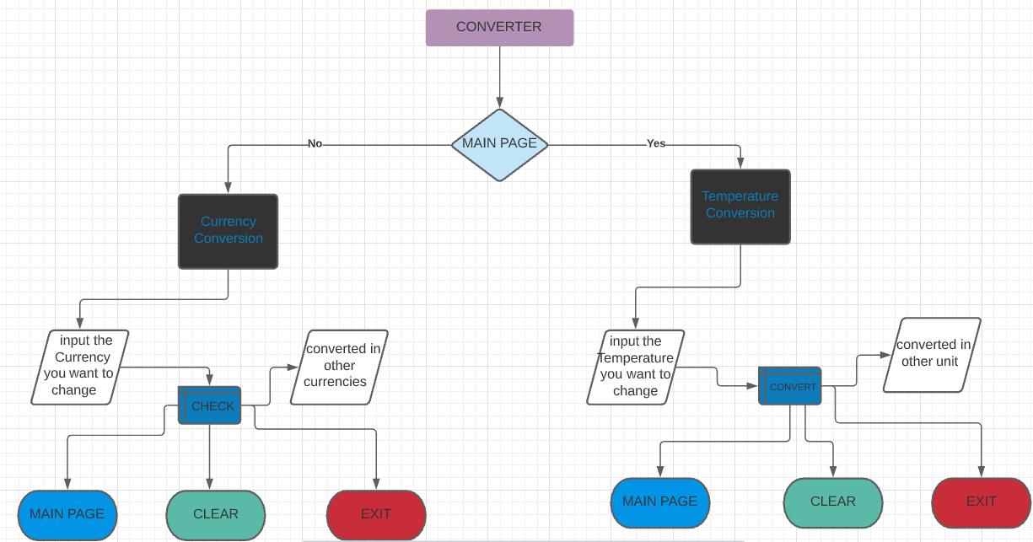



Slide 6

WORKING OF PROJECT

Slide 7
THANK YOU

